Slide 1

URL SHORTENING SERVICE
GROUP-13
mAYAnK SHARMA (14103064)
SANKET KUMAR (14103073)

Slide 2

What does it do?
Takes in a very long URL and outputs a short URL.
The short URL then redirects to the original long URL.

Slide 3
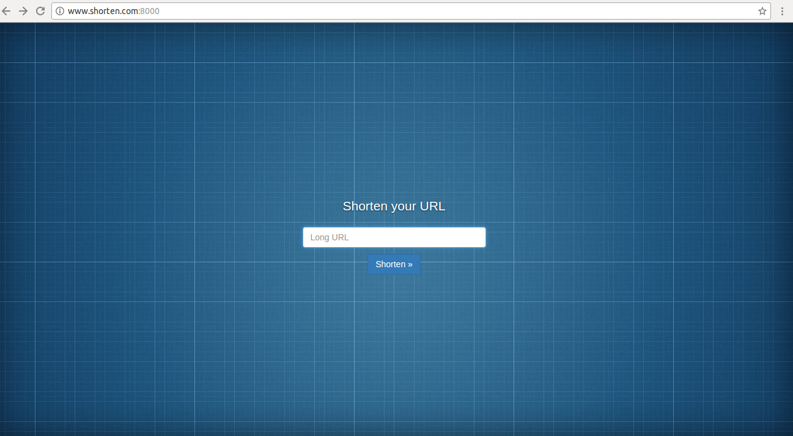
Home Page (www.shorten.com:8000)

Slide 4
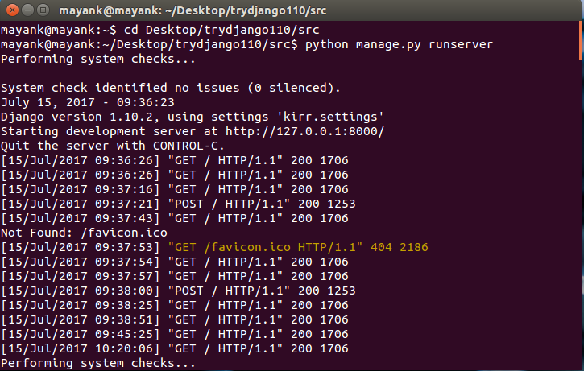
How does it work?
Run server on your pc in the directory of the project
Server Started Succesfully!

Slide 5
Open your Browser and go to any of the following Addresses www.shorten.com:8000 www.blog.shorten.com:8000
Page Started Successfully!

Slide 6
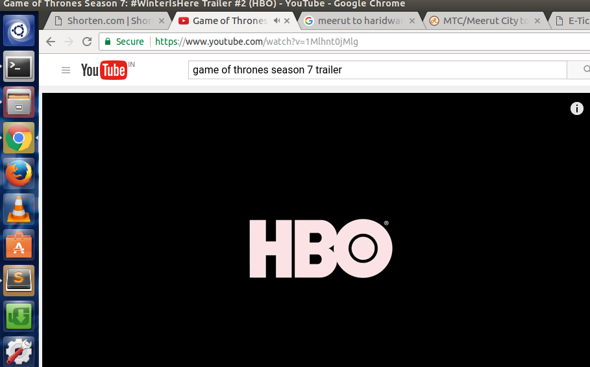
Take any long url from the web

Slide 7
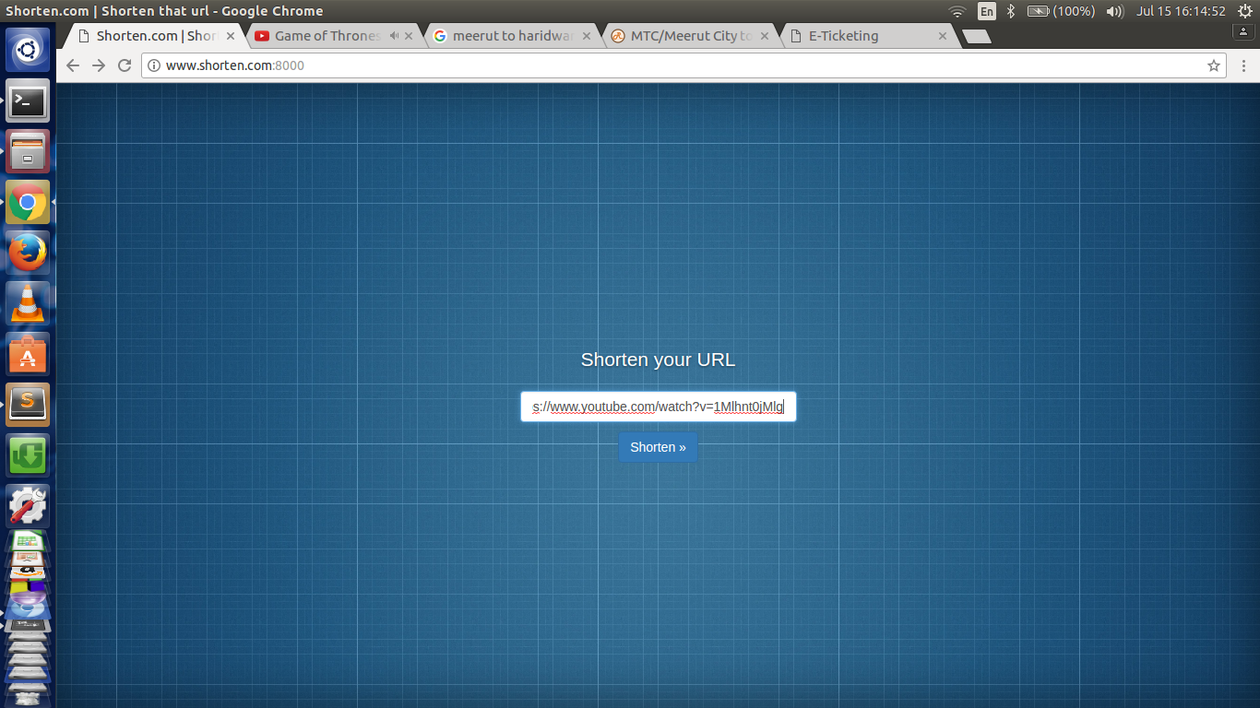
Paste the link in the space provided
Hit Shorten>>

Slide 8
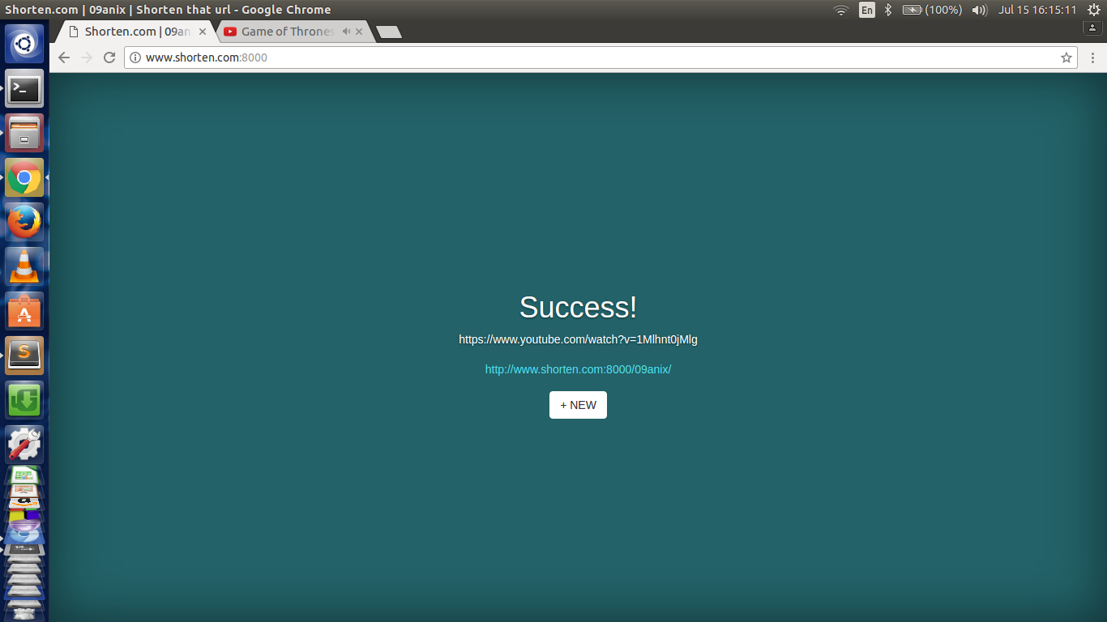
A Success Page will be shown with the desired short URL.

Slide 9
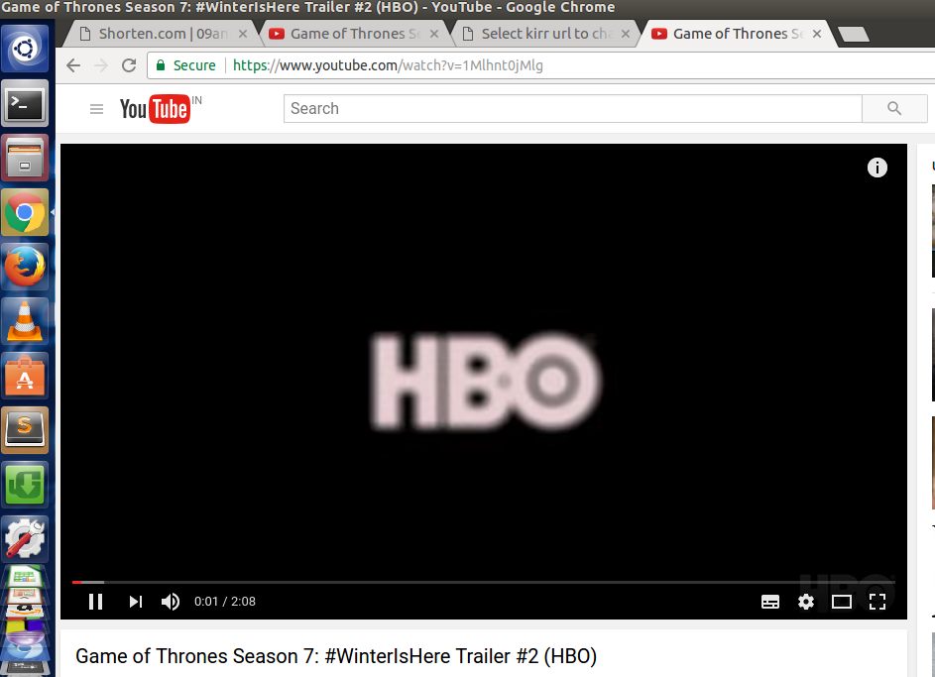
Clicking on the short URL will redirect us to our desired original Link.

Slide 10
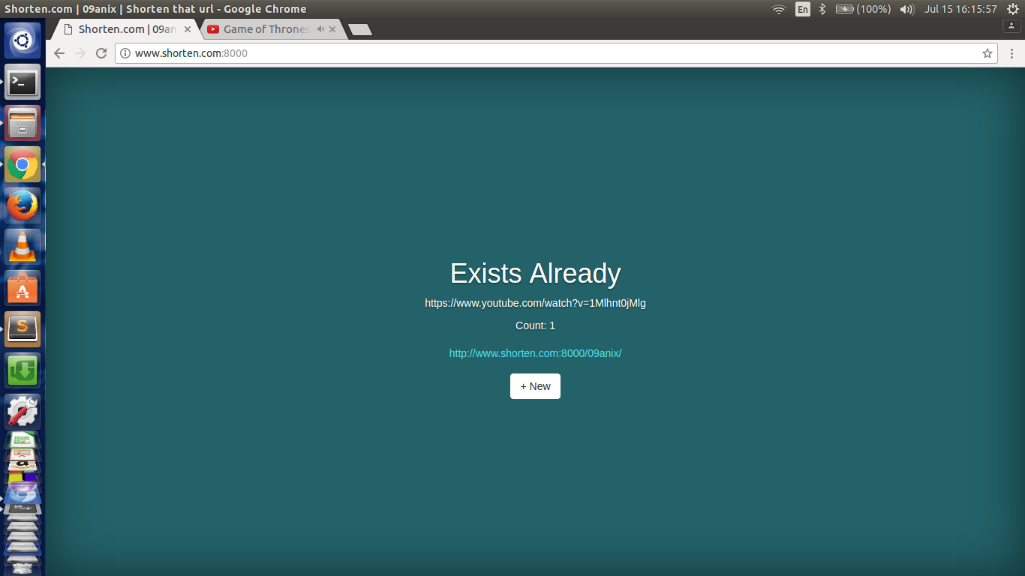
If we submit the same URL again to shorten, it will show us that the short URL already exists and will show the count of how many times the link has been accessed.

Slide 11
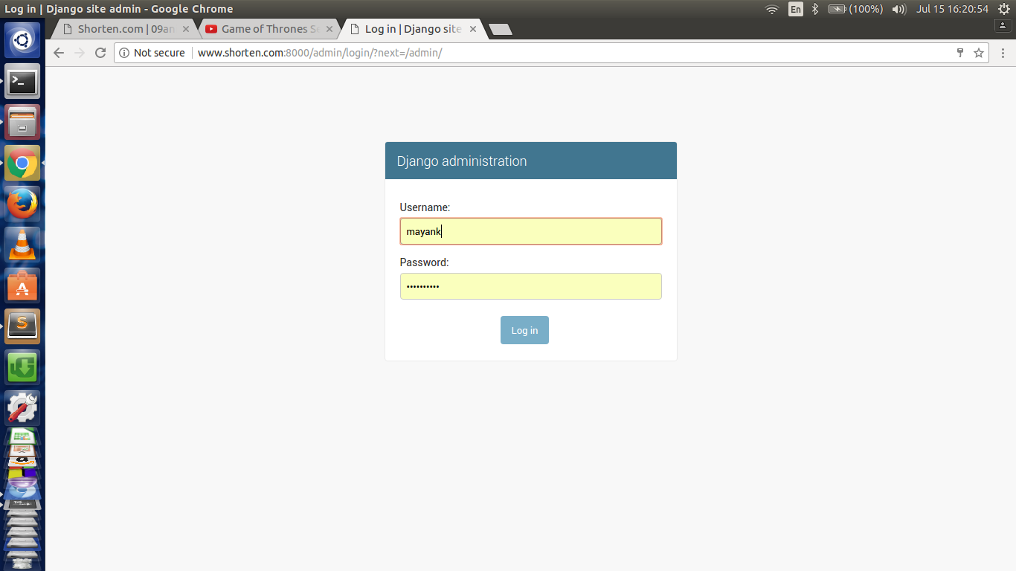
Super User Login:
The Super User can log in to the Django Administration using the following address 127.0.0.1:8000/admin

Slide 12
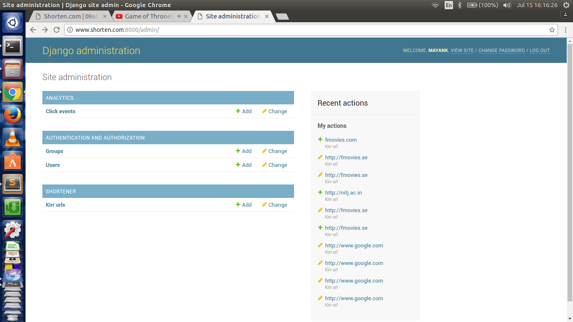
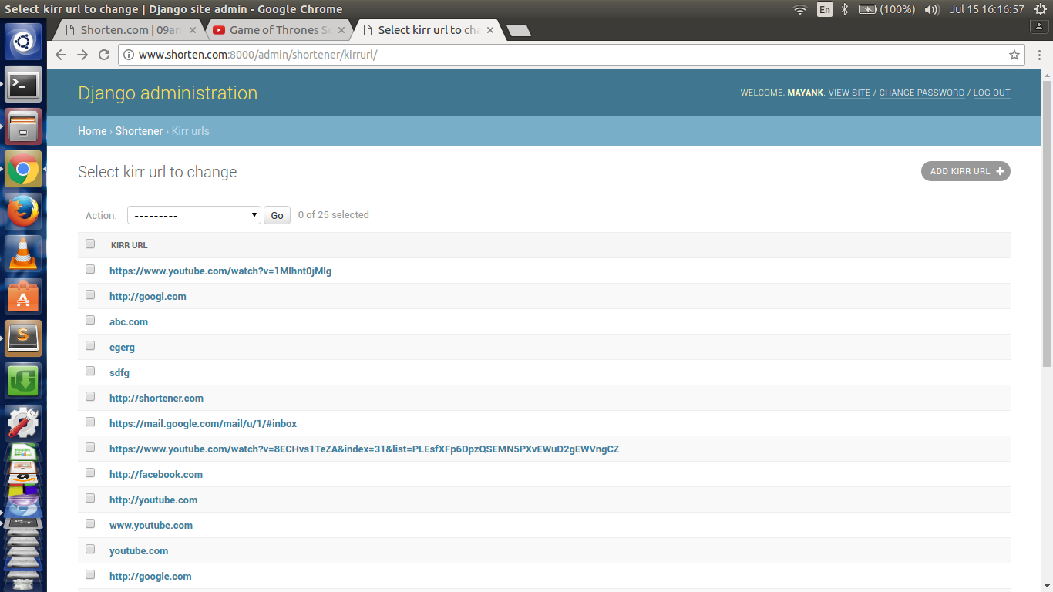
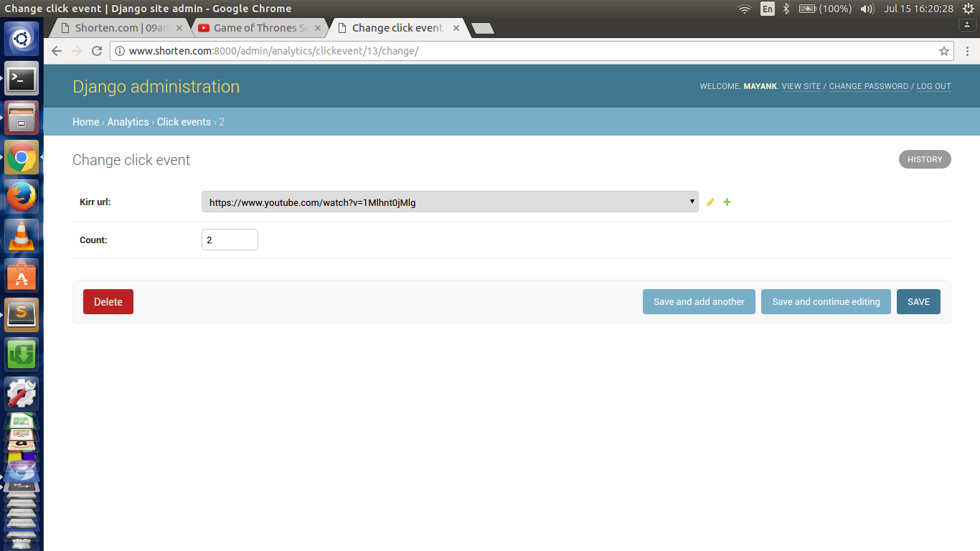
The User will now have access to the site database being used in the service.

Slide 13
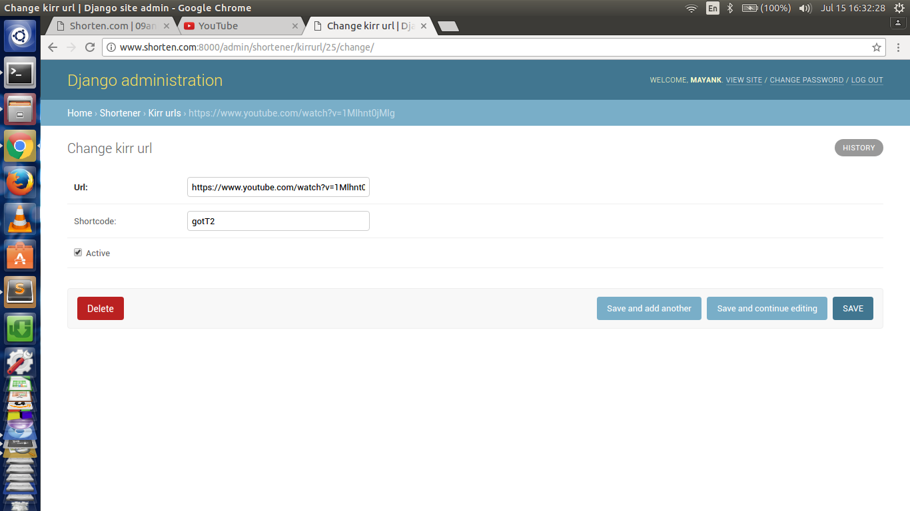
Short URLs can be changed by the user as per his convenience.

Slide 14
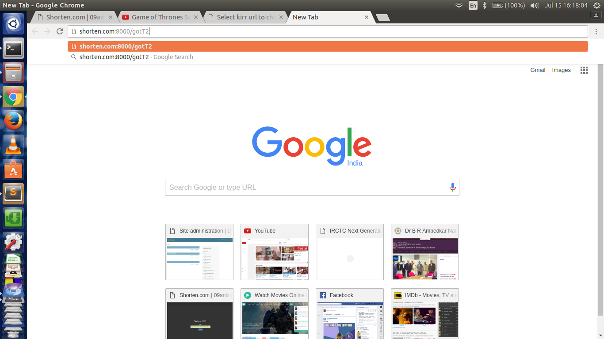
Now the new Short URL will work instead of the previous one.

Slide 15
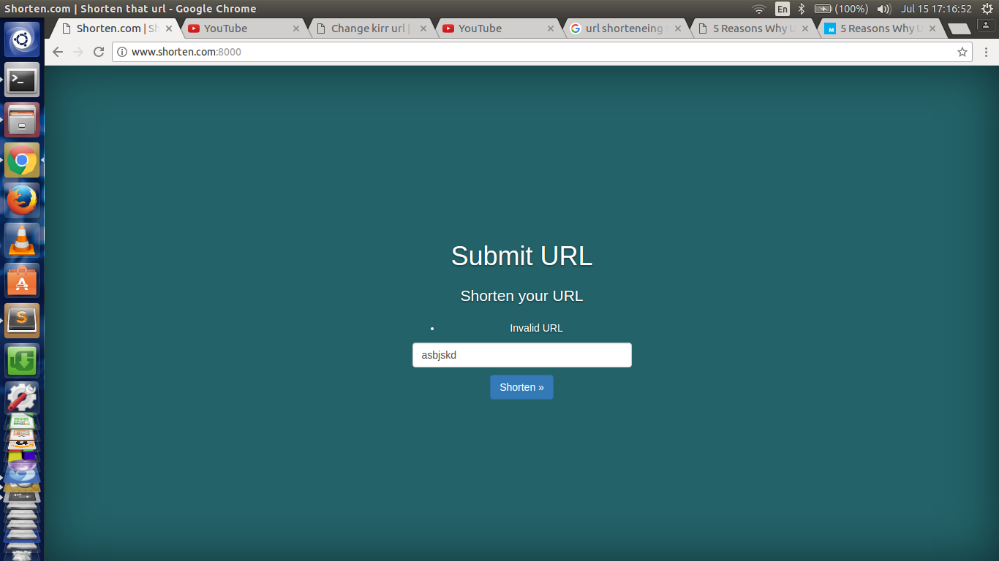
The service uses URL validators as to check whether the input URL is valid or not. If it is not valid, a message will be shown.

Slide 16
Benefits…?
Ability To Track The Performance Most URL shorteners provide analytical data. All shortened goo.gl links (which is what eClincher uses) do so and this information is easily accessible within eClincher. By tracking the success of links, a business can understand what their audience is engaging with and adjust their strategies accordingly.
Promotes Sharing Shorter links make sharing significantly easier, which promotes sharing as a whole. We are all hoping to get as many shares as possible when we post. So why would we want to make the process of sharing any harder than it has to be?
Higher Click Through Rate People are used to seeing shortened links on social media. Due to this, using shortened links will increase your click through rate. It is one of the simplest changes you can make to your posting strategy in order to increase the effectiveness.
Uses Less of Your Precious Characters
When it comes to Twitter especially, saving every possible character is critical. Getting your message across in 140 characters or less can feel like rocket science at times. Now try doing it with a link that is 75 characters long. Seriously.. try it. It‘s nearly impossible. Also consider the optimal tweet length is somewhere around 110 characters and you can see the problem.

Slide 17
THANK YOU

